Slide 1
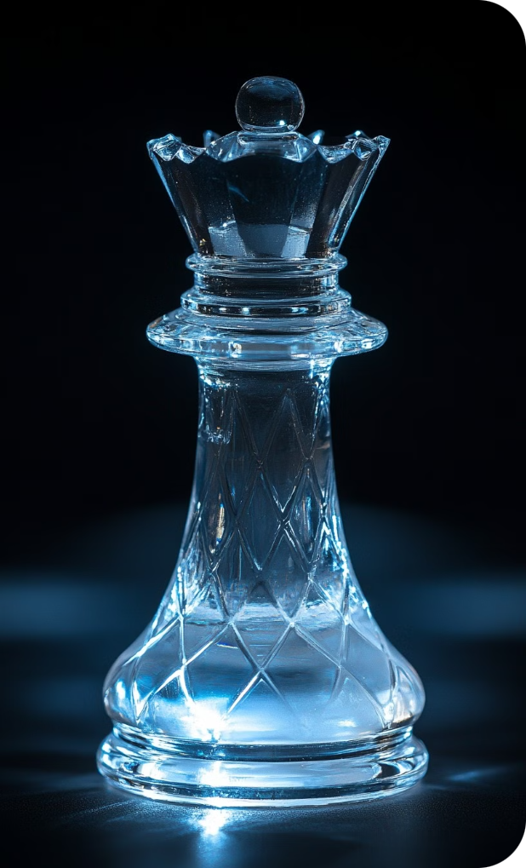
MINOR PROJECT
Name:
ALOK KUMAR
Roll No:
22020107003
Course:
B. VOC. SOFTWARE DEVELOPMENT
GitHub:
GitHub Repository Link

Slide 2
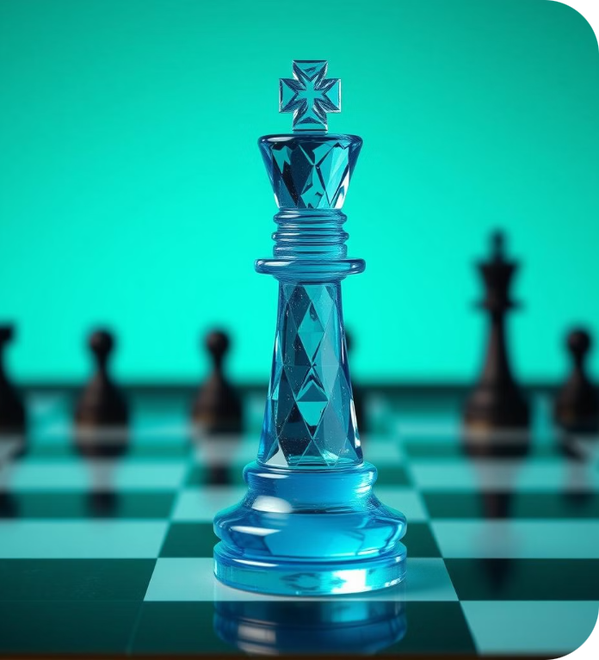
Machine Learning in Chess
This presentation explores how machine learning has revolutionized chess, from understanding the game's fundamentals to the development of powerful chess engines. We will dive into the different machine learning techniques used in chess, examining their advantages and limitations. We will also discuss how machine learning impacts the future of chess.

Slide 3
Understanding the Fundamentals of Chess
Board & Pieces
Movement Rules
Objective
Variations
Chess is played on a board with 64 squares, divided into 8 rows and 8 columns. There are six types of pieces: pawn, knight, bishop, rook, queen, and king.
Each piece has unique movement rules, including straight lines, diagonals, and special moves like castling. Pieces can be captured by landing on the same square.
The goal is to checkmate the opponent's king, meaning it is in a position where it can be captured on the next move. Players take turns moving one piece.
Chess has various variations, including blitz, bullet, and Fischer Random, which change the game's rules and time constraints.

Slide 4
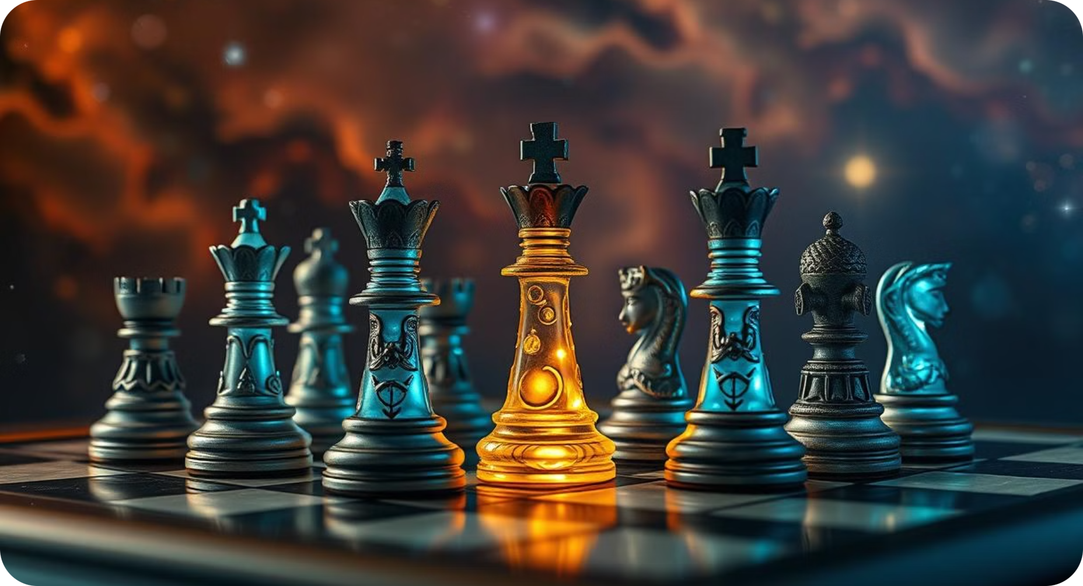
How Machine Learning Algorithms Learn to Play Chess
1
Data Input
2
Pattern Recognition
3
Prediction and Evaluation
4
Continuous Improvement
Machine learning algorithms learn from massive datasets of chess games, including historical moves, opening strategies, and endgame positions.
Algorithms analyze these datasets to identify patterns and relationships between moves, board states, and outcomes.
Based on identified patterns, they predict the best possible move in any given situation, evaluating potential moves based on their probability of leading to a win.
Through ongoing training and play, machine learning models refine their strategies and tactics, constantly improving their performance.

Slide 5





Exploring the Different Machine Learning Techniques in Chess
Neural Networks
Decision Trees
Deep neural networks analyze complex board patterns and strategic nuances, learning to predict optimal moves.
Decision trees break down the decision-making process into a series of steps, allowing the algorithm to analyze and evaluate moves.
Search Algorithms
Reinforcement Learning
Algorithms like Min-max explore potential moves to a certain depth, evaluating their impact on the game's outcome.
Algorithms learn through trial and error, improving their strategies based on the results of their moves in simulated games.

Slide 6




Advantages of Machine Learning-Powered Chess Engines
Unmatched Calculation Speed
1
ML engines analyze millions of possible moves per second, surpassing human capabilities.
Objective Evaluation
2
They remove emotional bias and fatigue, making unbiased evaluations.
Vast Knowledge Base
3
They learn from massive datasets of chess games, providing immense strategic depth.
Continual Improvement
4
Through training and play, they continuously improve their skill and strategy.

Slide 7
Backend for the game logs
Data Collection
1
Game logs are collected from various sources.
2
Data Cleaning and Processing
Raw data is cleaned and processed to remove errors and inconsistencies, preparing it for analysis.
Data Storage and Retrieval
3
Cleaned data is stored in efficient databases, allowing for fast retrieval and analysis.
4
Data Analysis
Machine learning algorithms analyze the data to identify patterns, trends, and insights.
Insights and Applications
5
Findings from data analysis are used to improve chess engines and understand the game's evolution.

Slide 8
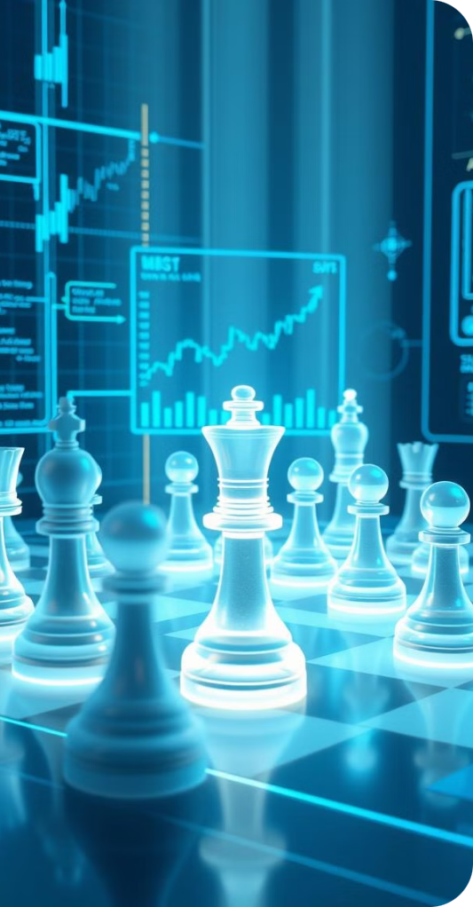




Uses Min max algorithm
Evaluate Moves
The algorithm evaluates potential moves for both players, assuming perfect play.
Maximize Own Score
It aims to maximize the player's own score while minimizing the opponent's score.
Recursive Calculation
It recursively explores possible moves for both players, evaluating potential outcomes.
Decision Making
The algorithm chooses the move that leads to the most favorable outcome for the player.

Slide 9
Improvements for Future
1
Enhanced Pattern Recognition
Develop algorithms that can identify more complex and nuanced patterns in chess games.
Improved Learning Efficiency
2
Train models faster with more efficient algorithms, allowing for quicker learning and adaptation.
Hybrid Systems
3
Combine machine learning with human intuition and experience to create even more powerful engines.
Personalized Learning
4
Develop models that tailor their training and strategy to individual players and playing styles.

